Slide 1


Workshop: Response Bias in Self-Report Measurements Acquiescence
Dr. Ricardo Primi
Universidade São Francisco (USF) and Ayrton Senna Institute Edulab21 (IAS)
Dr. Felipe Valentini
Universidade São Francisco (USF)
ITC Granada, Sapain, July, 2024
Notes:
I would like to thank you for your attention, the search committee, and GSE for the opportunity to discuss my work
I am really honored to be here

Slide 2
Programme for International Student Assessment (PISA)
Assessing social and emotional skills as outcomes
PISA has been an important system for providing benchmarks for international comparisons and monitoring trends over time.
Cognitive tests measure the ability to apply knowledge to solve practical problems (language, math science, and an innovative domain).
Self-report questionnaires assess additional constructs such as social-emotional skills (Bertling & Alegre, 2018).
explanatory factors of learning outcomes
outcomes of 21st century education

Slide 3
Examining aptitude achievement paradox in PISA
The challenge with PISA self-assessment is how to achieve cross-culturally comparable measures.
How can we compare different cultures in self reported perseverance for instance?
Aptitude-achievement paradox (Kyllonen & Bertling, 2013).
There have been many attempts to solve this problem (like anchoring vignettes), but none have been completely successful
One of the techniques, we used in SENNA to control acquiescence and assist with resolving part of this issue.
Primi, R; Bertling, J., Kyllonen, P., Hauck-Filho, N., & Valentini, F. (2019) Acquiescence and attitude-achievement paradox in PISA 2012. Paper presented at 84th Annual Meeting of the Psychometric Society, Santiago, Chile.

Slide 4
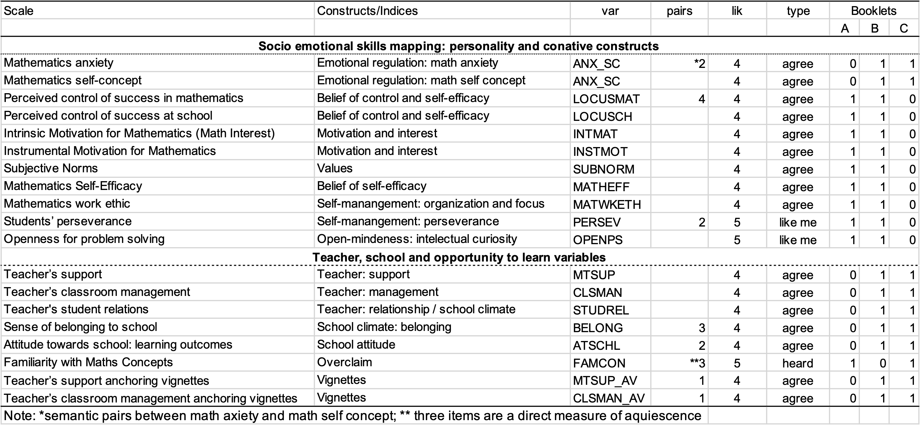
PISA 2012
Reanalysis of data on social and emotional characteristics
480,174 students from 66 countries and economies
17 scales
Inconsistent index based on 18 pairs of items
We proposed a method for rescaling responses and rescoring that controls for inconsistent responses
Primi, R; Bertling, J., Kyllonen, P., Hauck-Filho, N., & Valentini, F. (2019) Acquiescence and attitude-achievement paradox in PISA 2012. Paper presented at 84th Annual Meeting of the Psychometric Society, Santiago, Chile.

Slide 5
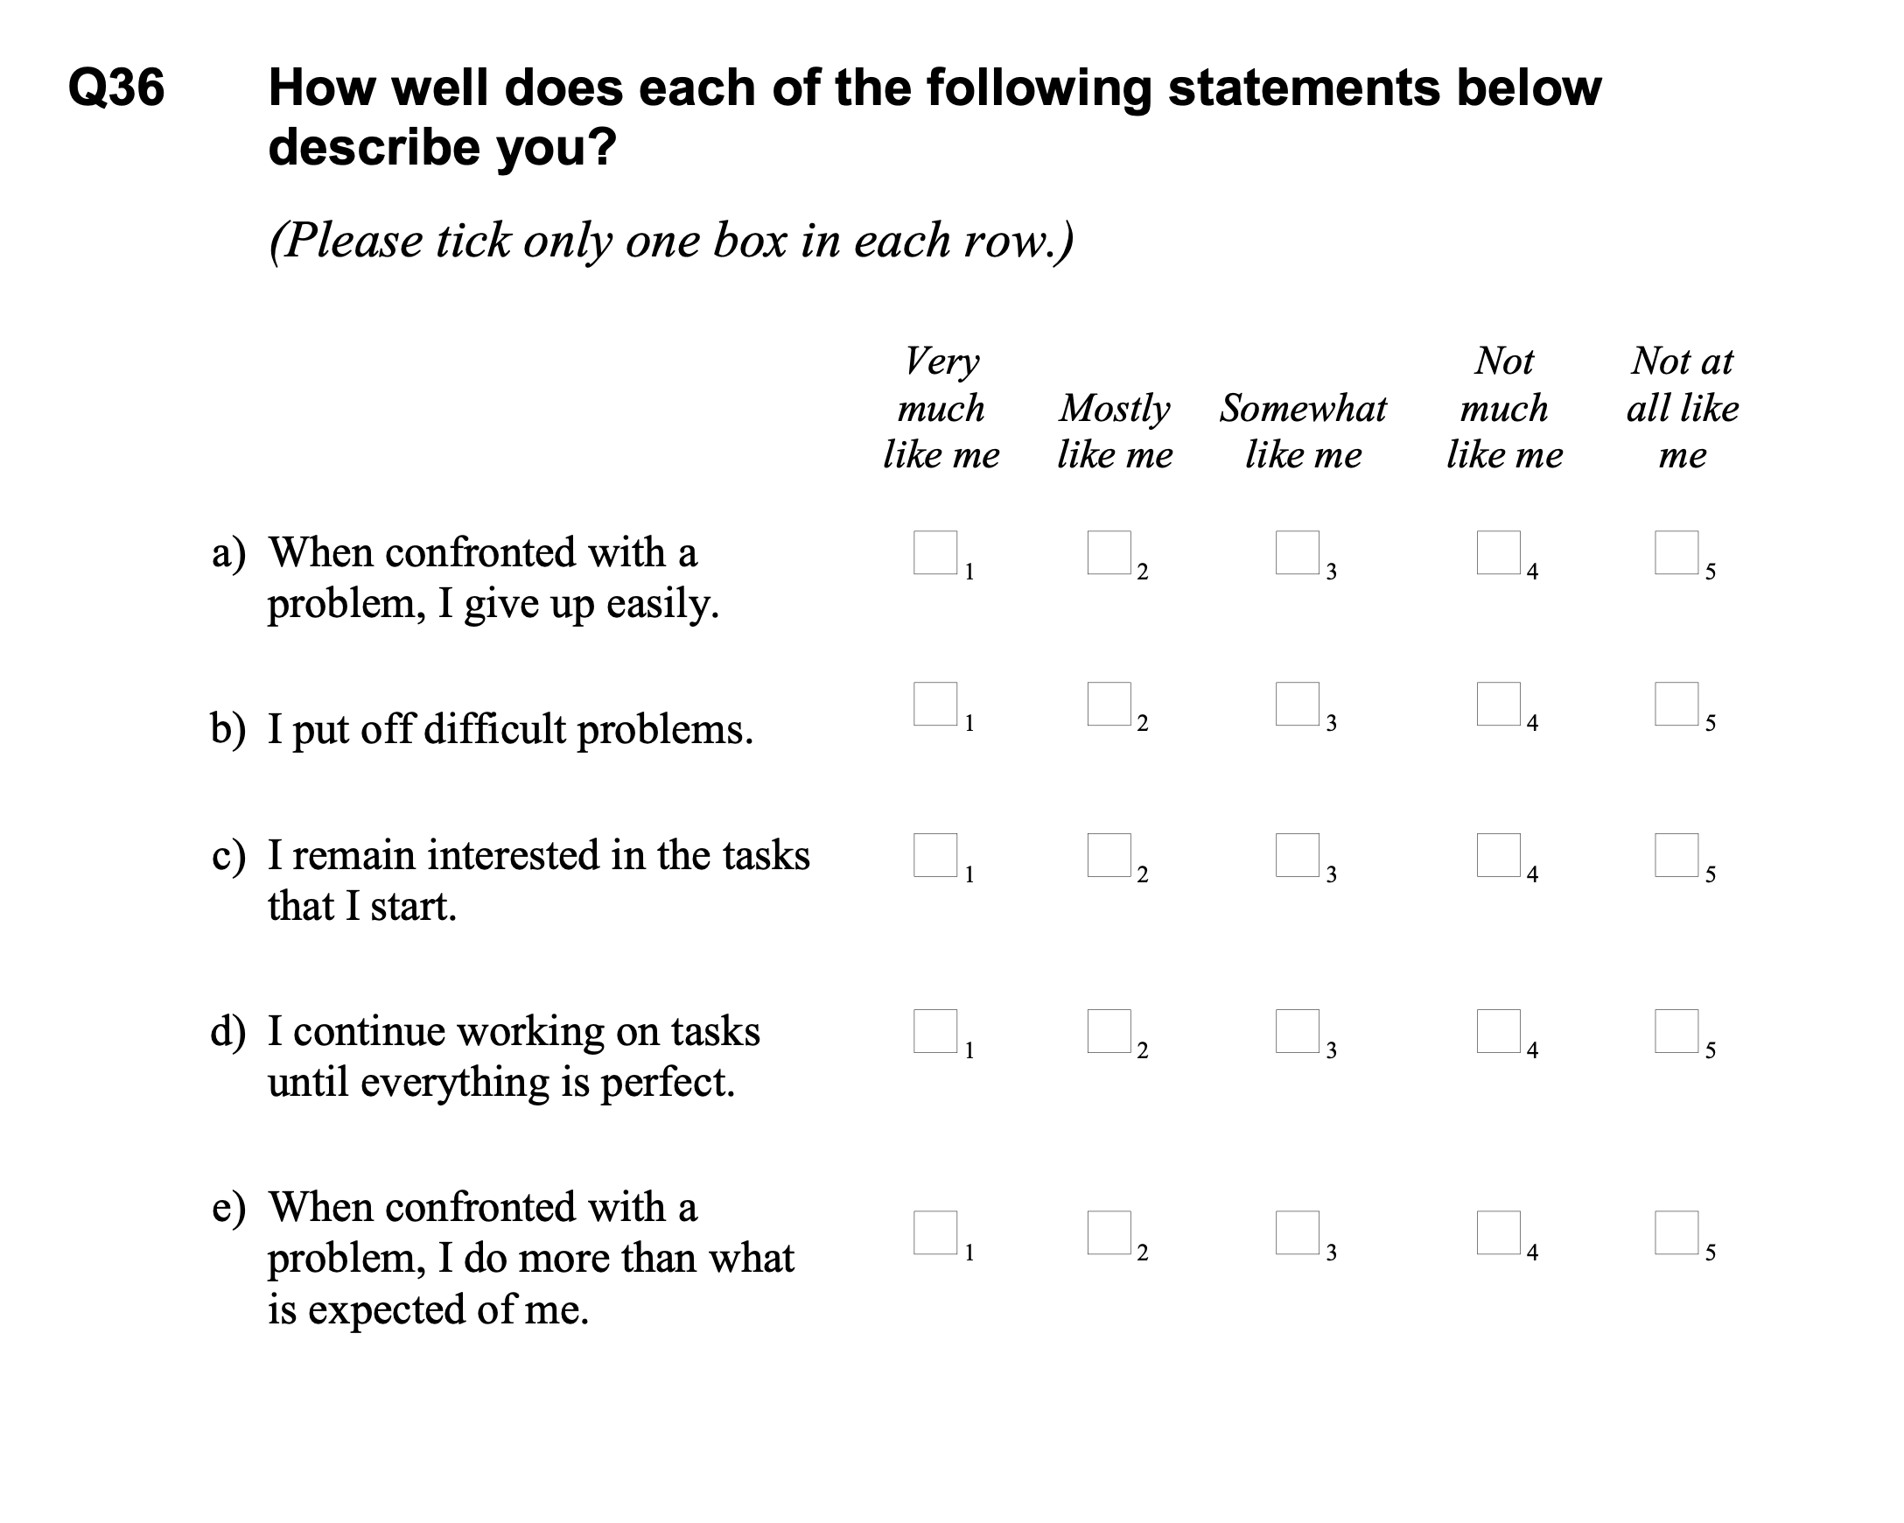
Perseverance scale PISA 2012
Notes:
Lets focus in perseverance

Slide 6
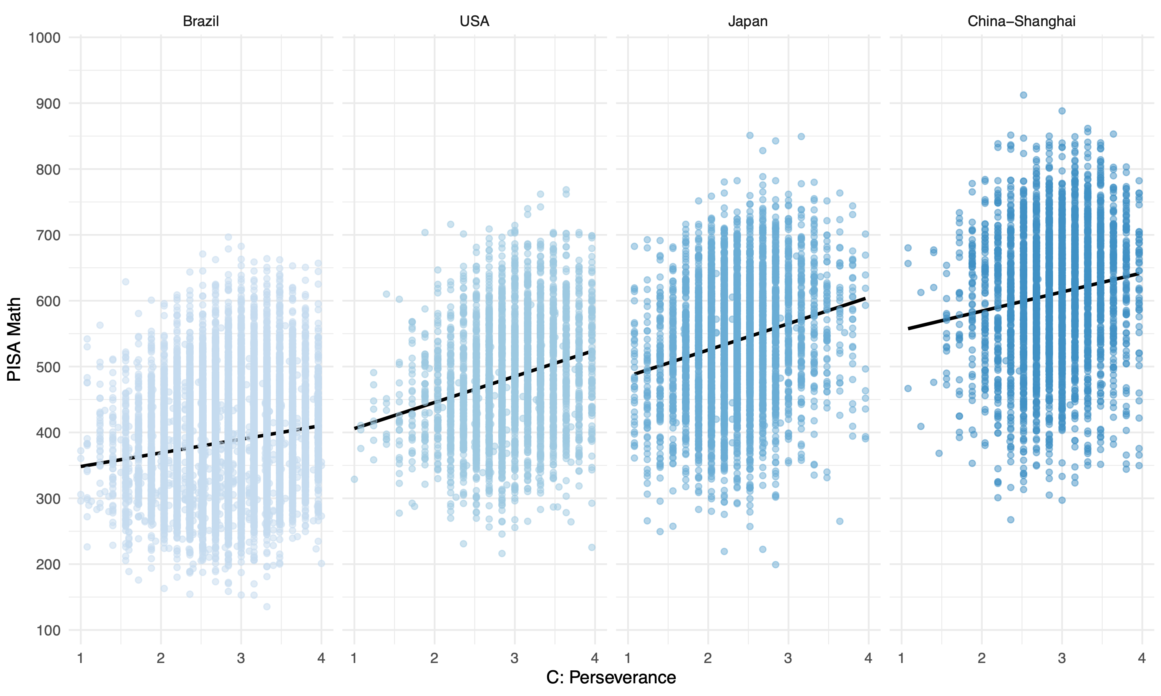
Aptitude achievement paradox
r = .21
r = .26
r = .17
r = .10
Notes:
What is aptitude achievement paradox?

Slide 7
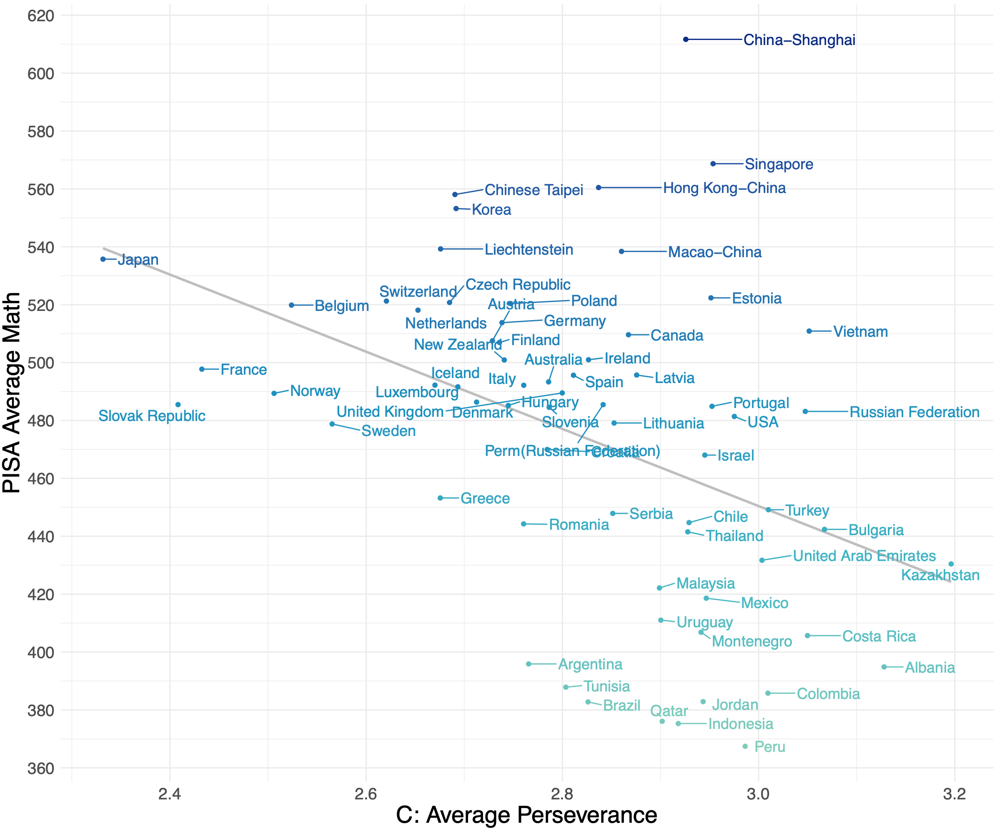
Aptitude achievement paradox
r = -.42
Example of a Simpson’s paradox when we encounter data where “an association that is observed on entire population reverses in every subpopulation” (Pearl et al., 2016, p. 3)
Notes:
We cannot use a relationship in one level (country) to make inferences about the relationship in another level (individuals)- ecological fallacy. Associations at the aggregate level say something about the macro-level unities (country) that is different from associations seen at micro-level students unities. But although we have plausible explanations for the positive association at the individual-level data, little is known about what a negative correlation at the country level would mean about countries

Slide 8

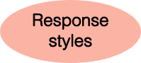
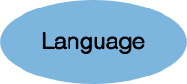


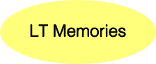
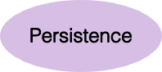
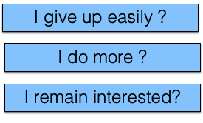
Self-report is a rater mediated assessment
When confronted with a problem:
Notes:
Personal characteristics interferes in the assessment
We will propose a measure of motivation/verbal skills via an index of inconsistent responses
Measurement is possible when we have logical opposites
A method for assessing motivation, carelessness responding, and insufficient effort responding

Slide 9


Inconsistent agreement responses
index from positive pole vs negative pole items
Consistent responses
When confronted with a problem I do more than it is expected of me
5
4
3
2
1
1
2
3
4
5
When confronted with a problem I give up easily
High persistence
Low persistence

Slide 10
Inconsistent agreement responses
index from positive pole vs negative pole items
Consistent responses
5
4
3
2
1
1
2
3
4
5
M = 3
M = 3
M = 3
M = 3
M = 3

Slide 11
Inconsistent agreement responses
index from positive pole vs negative pole items
Inconsistent responses
When confronted with a problem I do more than it is expected of me
5
5
5
5
2
3
4
5
M = 4,5
M = 5
M = 3,5
M = 4
When confronted with a problem I give up easily
High inconsistent
agreement
Consistent
Notes:
Acquiescence (agreement regardless of content)
The reverse is also true (as in inconsistent disagreement)
We can create an index: consistent responses are equal to 3 (2,5) and inconsistent responses are those that deviate from 3 (above or below)
We identified 18 pairs on PISA database and calculated this index.
This score can be associated with several possibilities. One is low motivation/low effort in reading questions
If so it will be related to low achievement

Slide 12
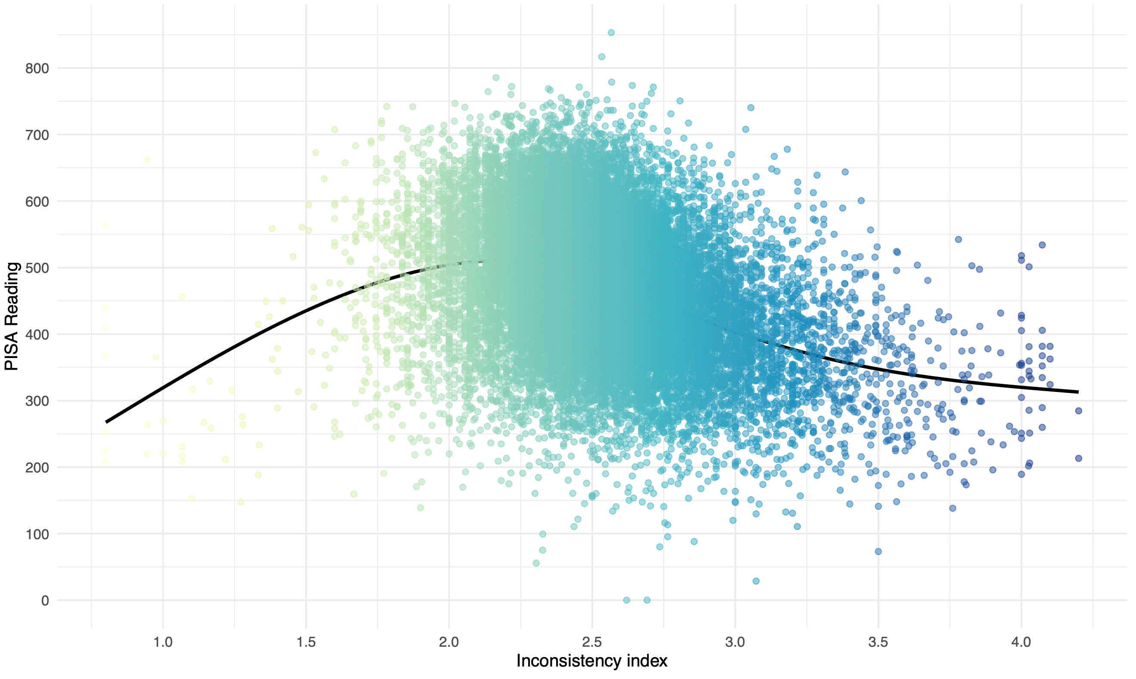
Inconsistency vs achievement
Inconsistency -> low achievement
r = -.32
Notes:
Sure enough

Slide 13
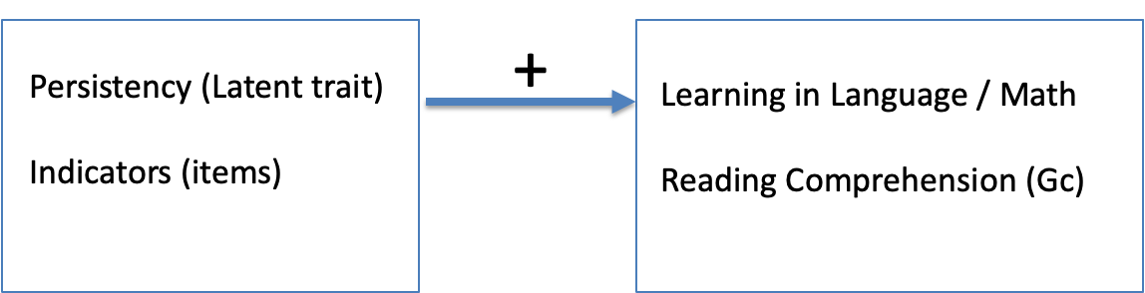
Understanding the problem

Slide 14
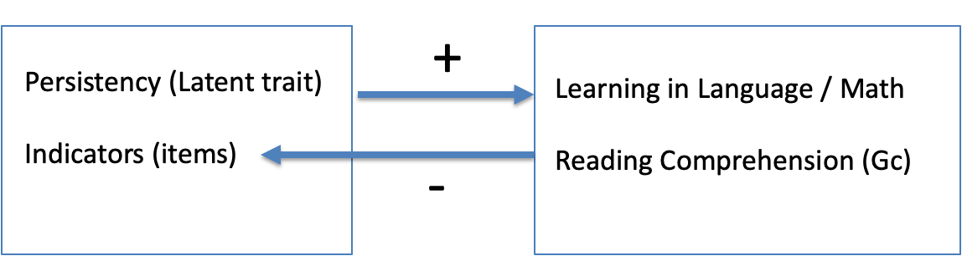
Understanding the problem

Slide 15
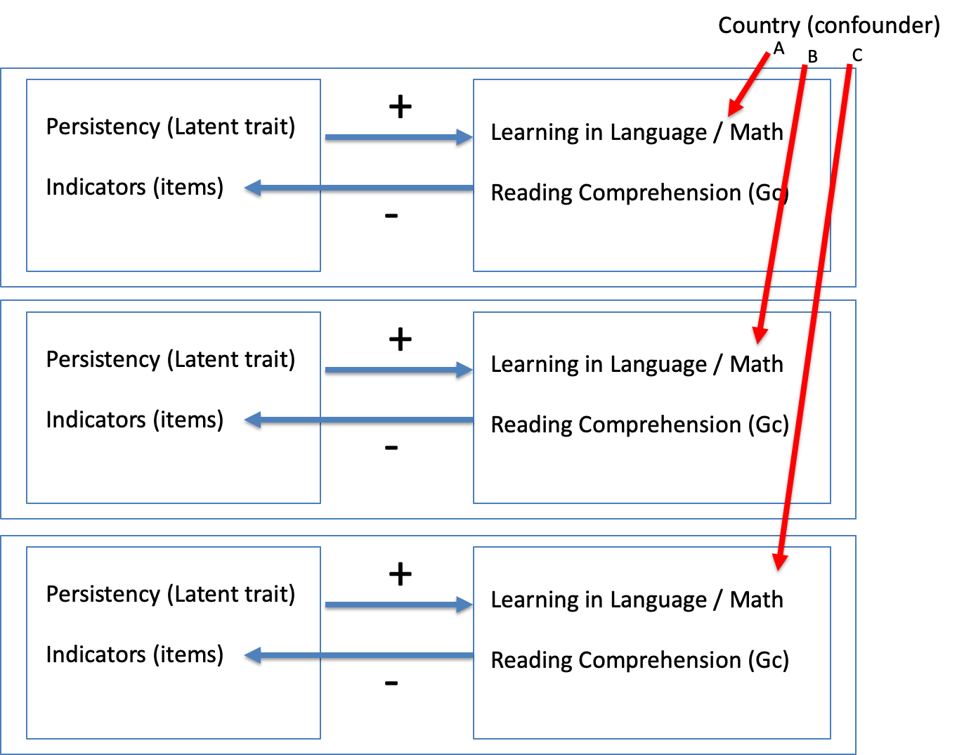
Understanding the problem

Slide 16
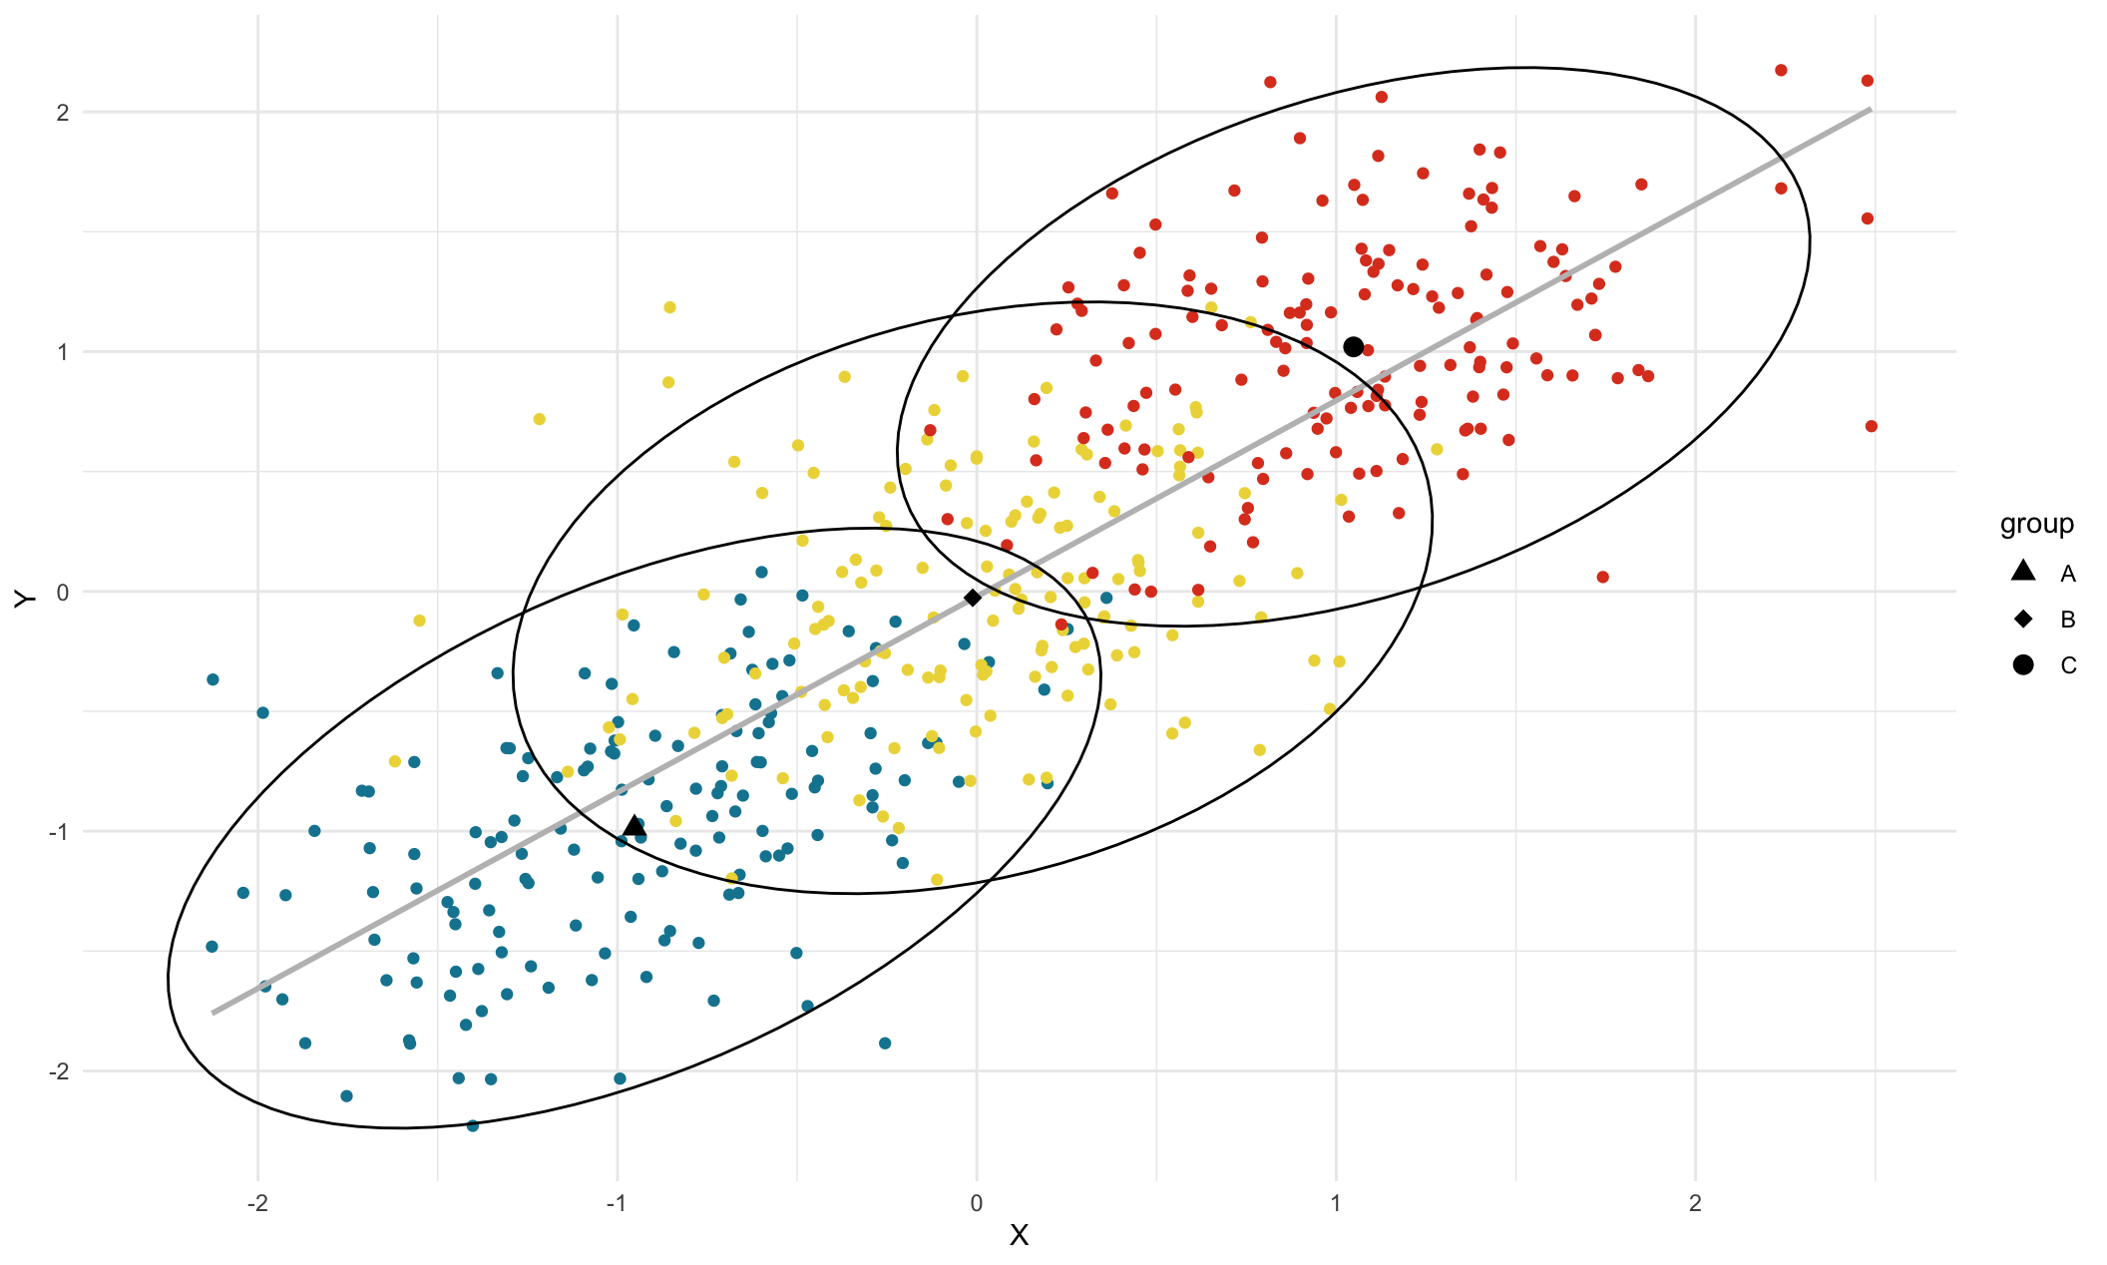

Slide 17
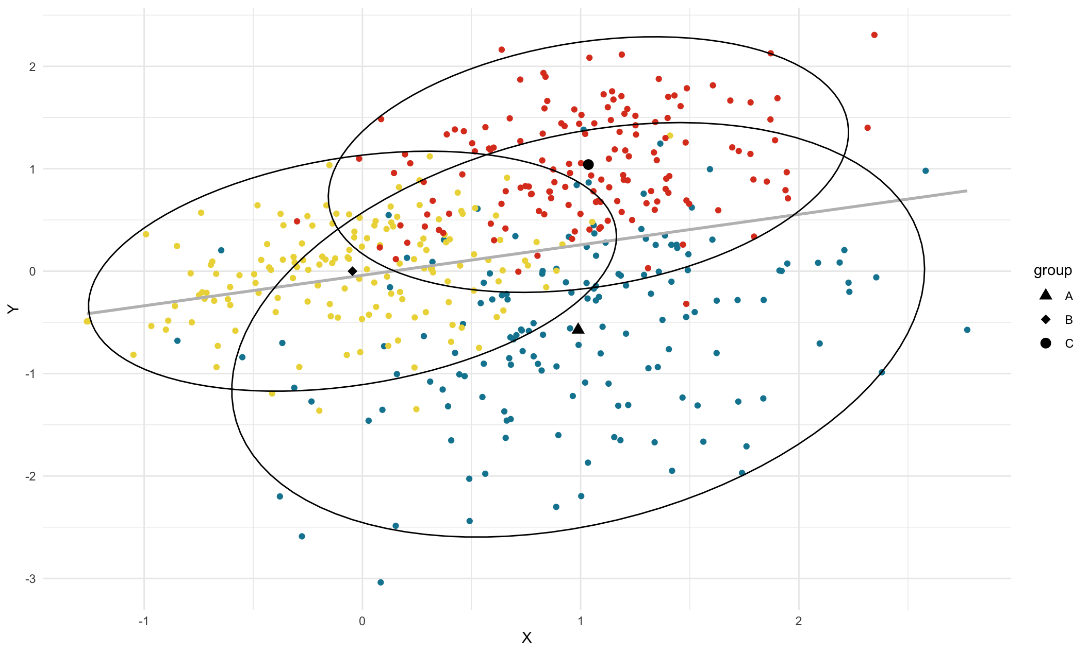

Slide 18
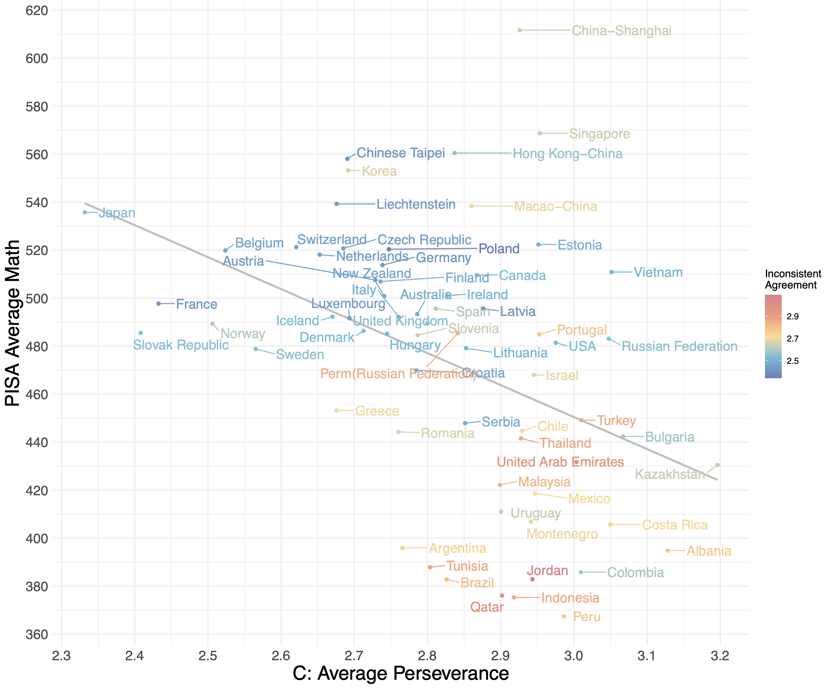
Revisiting aptitude achievement paradox
Notes:
Coloring each country by average inconsistency.
Rescoring method is a simple: we recalculate perseverance at the level of the individual subtracting their inconsistency index. It is a deviation score around inconsistency.
If I do that and average these scores

Slide 19
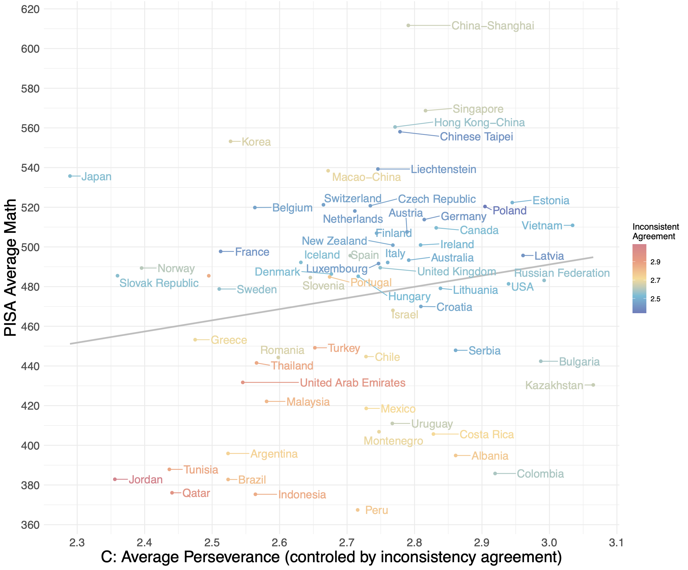
Solving part of the aptitude achievement paradox
Notes:
12 out of 17 scales showed paradoxical correlations, after the method we proposed
8 flipped from negative to positive, and 4 that were already positive increased!
Explanation of the Simpson’s Paradox in this case: Inconsistency is a suppressor confounder at the country level. It is negatively related to achievement and positively related to social and emotional skills. The magnitude of this positive relationship depends upon the ratio of the positive pole items to negative pole items comprising the scale

Slide 20
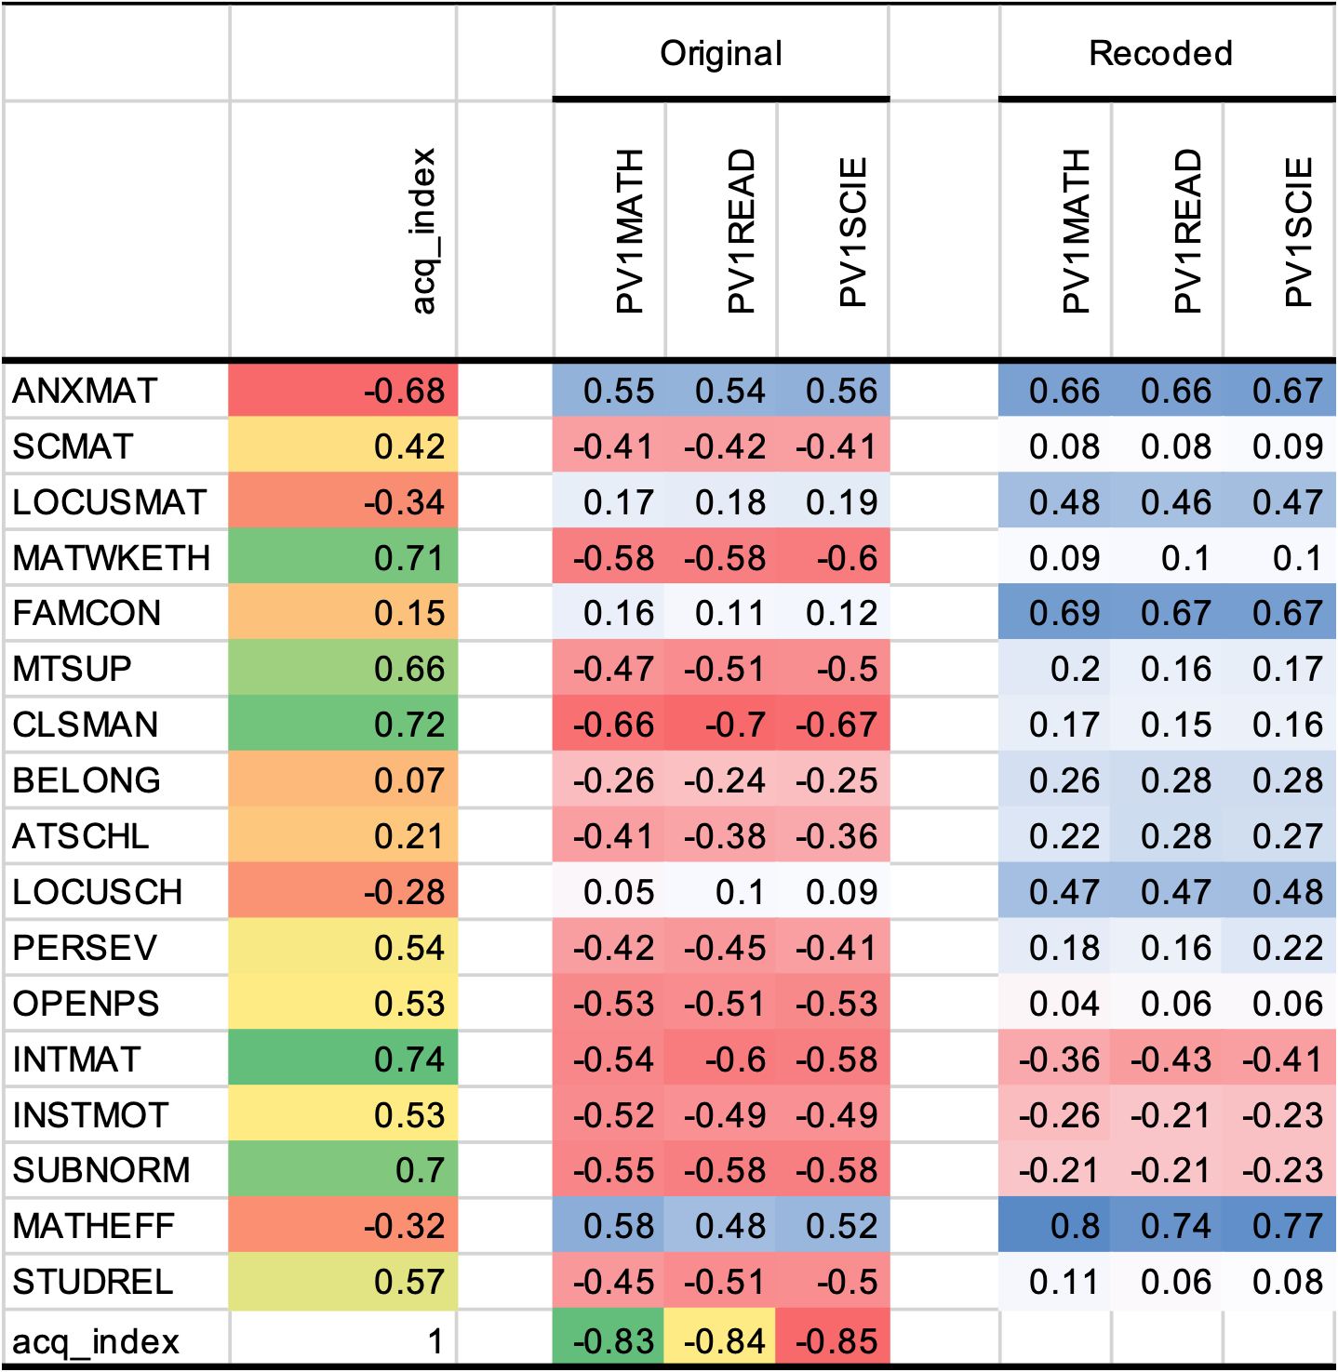
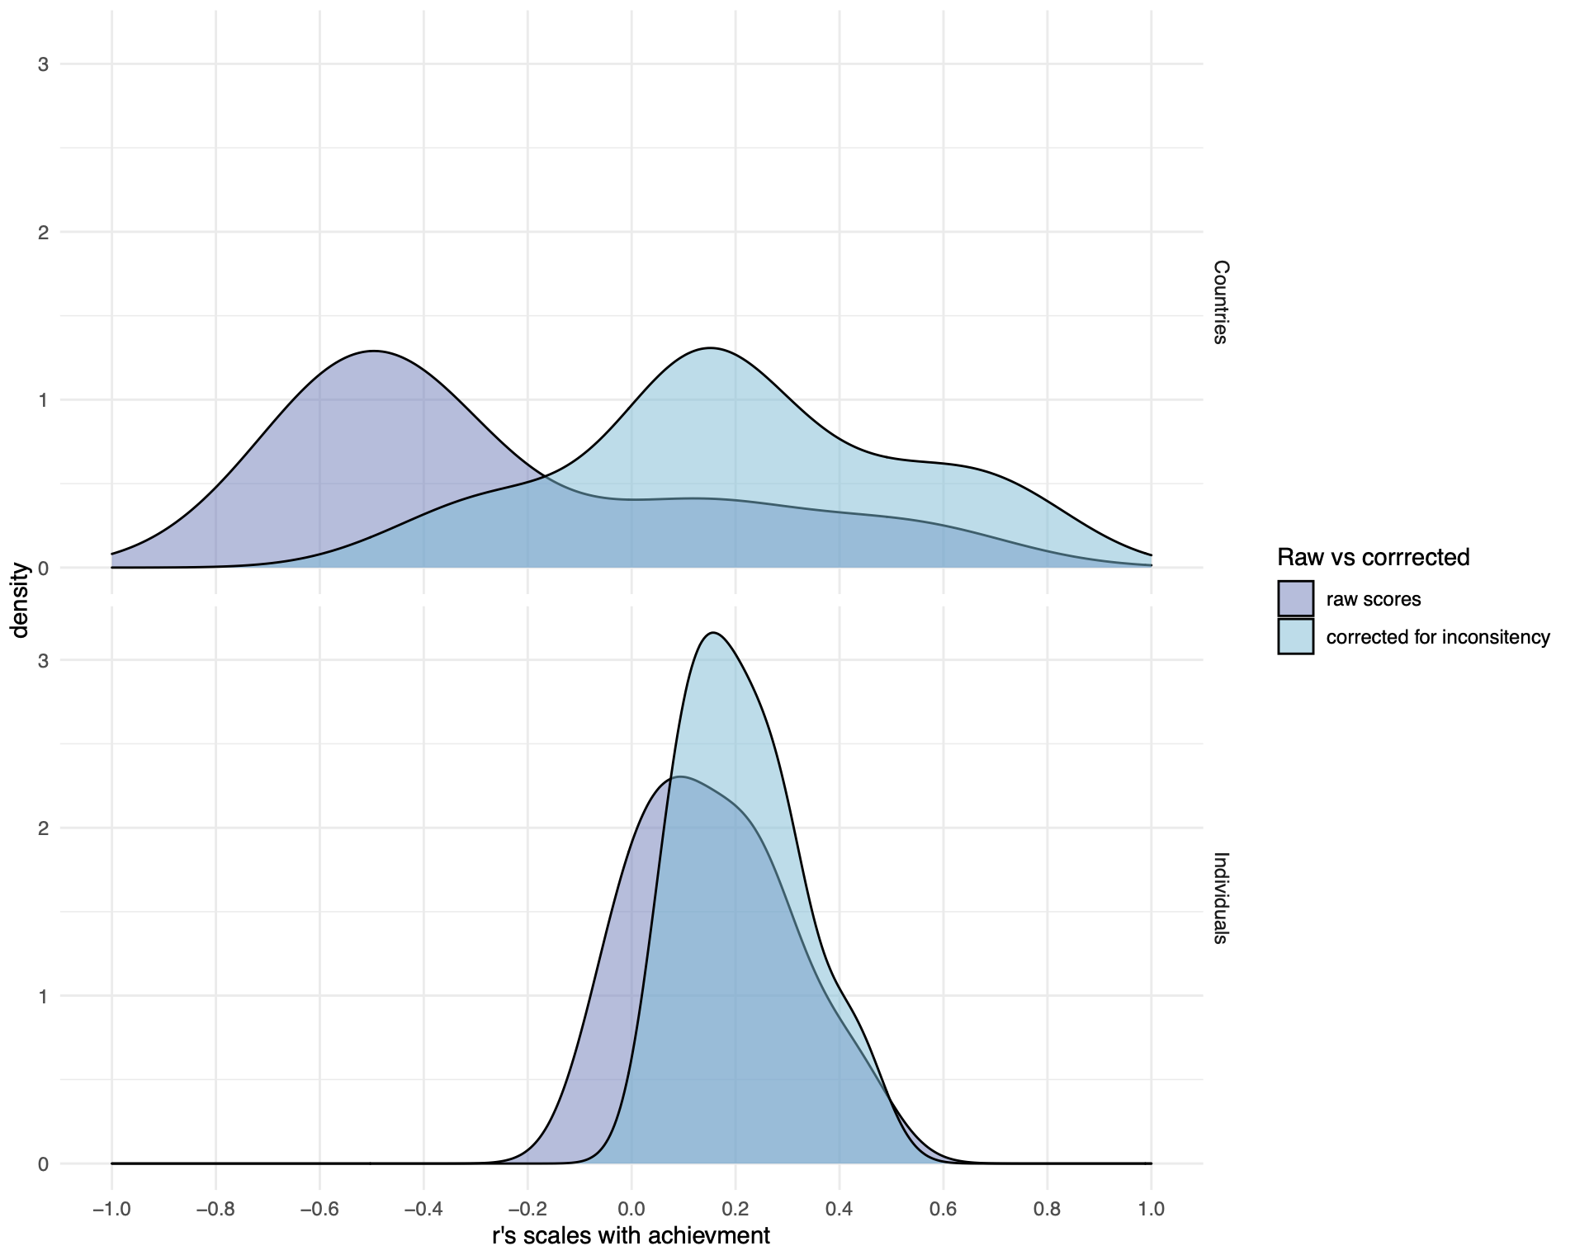

Slide 21
Conclusions
Acquiescence, a participant response style, accounts for a portion of the 'Attitudes-Performance' paradox. However, it does not elucidate all the issues encountered.
Beyond measuring socio-emotional skills, it is imperative to assess response styles, specifically how participants react to scales, in order to utilize this data for mitigating systematic measurement errors.
The inclusion of negatively worded items is essential!
Notes:
we have several limitations in self assessments

Slide 22
References
Bertling, J., & Alegre, J. (2019). PISA 2021 Context Questionnaire Framework (Field Trial Version). Educational Testing Services. https://www.oecd.org/pisa/sitedocument/PISA-2021-questionnaire-framework.pdf
Kyllonen, P. C., & Bertling, J. P. (2013). Innovative Questionnaire Assessment Methods to Increase Cross Country Comparability. In Handbook of International Large-Scale Assessment (Vol. 1–0, pp. 277–285). Chapman and Hall/CRC. https://doi.org/10.1201/b16061-15
Olderbak, S., & Wilhelm, O. (2020). Overarching Principles for the Organization of Socioemotional Constructs. Current Directions in Psychological Science, 29(1), 63–70. https://doi.org/10.1177/0963721419884317
Pearl, J., Glymour, M., & Jewell, N. P. (2016). Causal Inference in Statistics: A Primer (1a edição). Wiley.
Poropat, A. E. (2009). A meta-analysis of the five-factor model of personality and academic performance. Psychological Bulletin, 135(2), 322–338. https://doi.org/10.1037/a0014996
Santos, D., & Primi, R. (2014). Social and Emotional Development and School Learning: A Measurement Proposal in Support of Public Policy. São Paulo: EduLab21, Instituto Ayrton Senna. Available online at: https://globaled.gse.harvard.edu/files/geii/files/social-and-emotional-developmente-and-school-learning1.pdf (accessed November 23, 2016).

